Slide 1
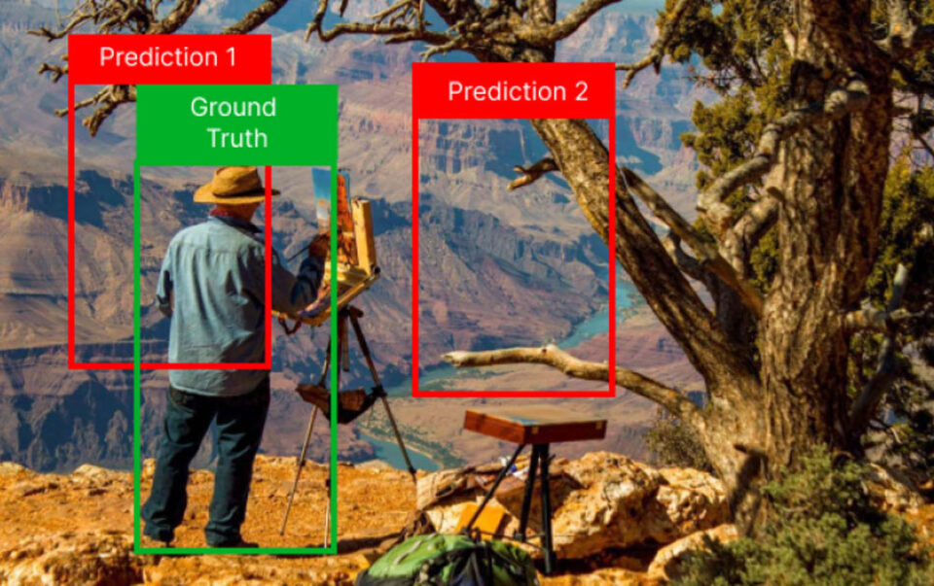


Object Detection Project
PPE detection

Slide 2
Flowchart of Project
Collection of Images for Dataset
Creating Gmail API to send message and Snapshot
Creating Front End
Dataset Creation through Annotation
Model Evaluation and Testing
Deployment on Docker
Download the Dataset
Model training
Running the Docker Container on DGX or JATSON

Slide 3
Collection of Images
Annotation of Images
Model Training
Approximately 2000 images
Roboflow
Kubeflow
Collection has to be done carefully

Slide 4
Objective
To detect person wearing PPE (Helmet & Jacket).
If any of the above is missing, then ‘PPE Violation Alert’ to be sent through Gmail with a Message and Screenshot

Slide 5
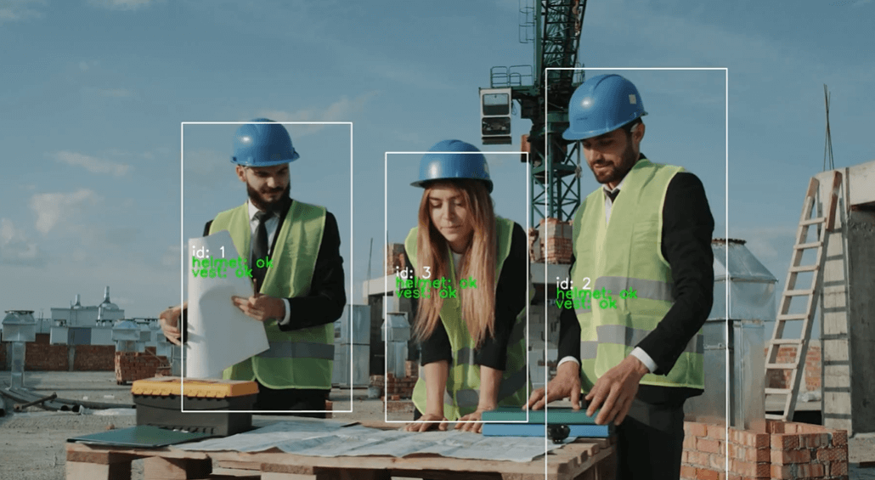
Test Results

Slide 6
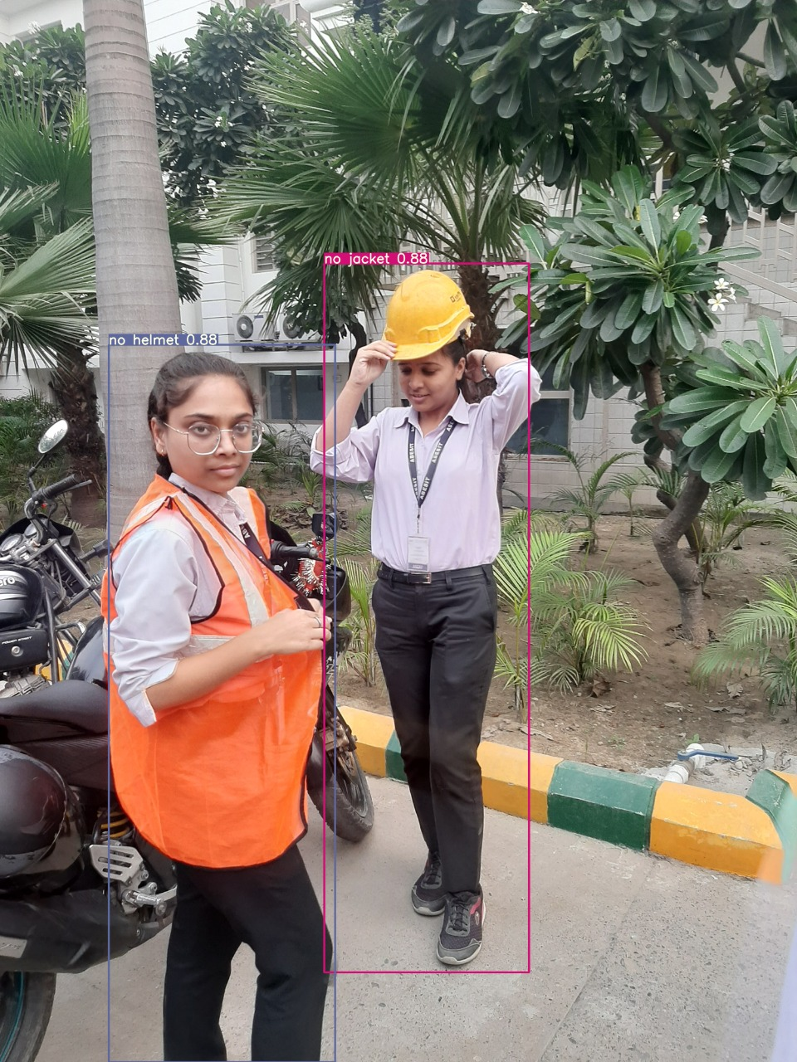
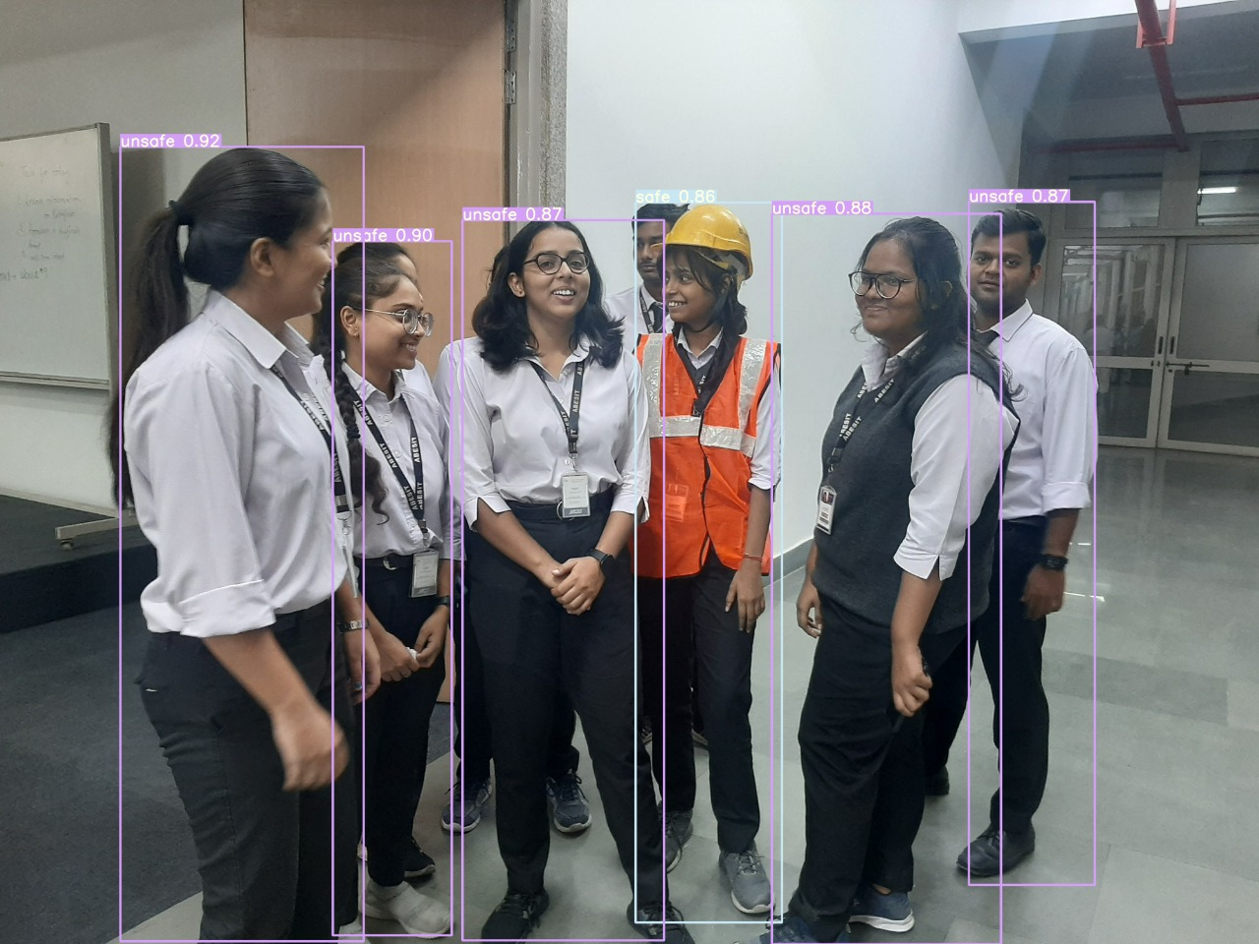
Test Results

Slide 7
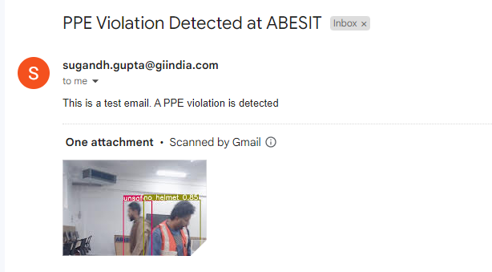
Results (GMail API)

Slide 8
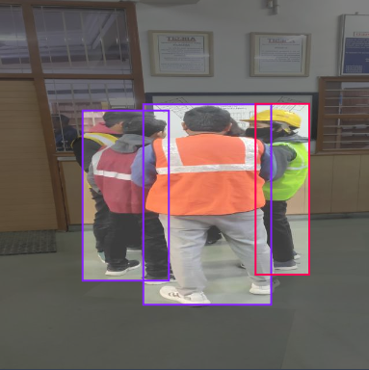
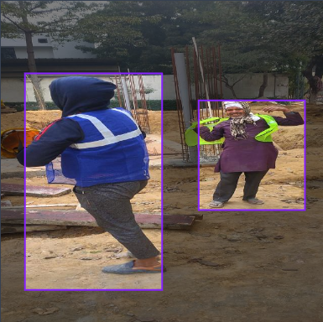
Observations Data Collection: Method 1

Slide 9
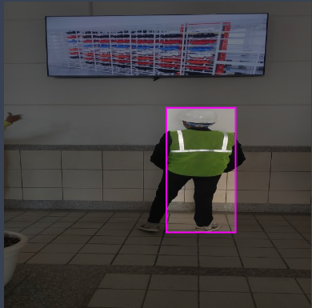
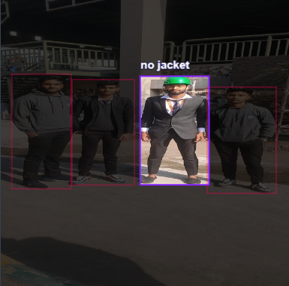
Observations Data Collection: Method 2

Slide 10

Health Check of Dataset in Roboflow!

Slide 11
Observations (Model Training)
 | mAP | Time Taken to train Model
Data Collection : Method 1 | low
Data Collection : Method 2 | high
Resolution : 320 x 320 | low | less as compared to 640 x 640
Resolution : 640 x 640 | high | more as compared to 320 x 320

Slide 12

Let’s get started….

